Slide 1
Cross Functional Team (CFT) Meeting Executive Secretariat (Exec Sec) SWIFT Digital Mail Solution March 30, 2021
OCIO Policy, Strategy and Planning (PSP) division
Shamila Beslow (business partner)
Enterprise Architecture

Slide 2
Business Need
Exec Sec is requesting guidance to identify a solution to scan/digitize all mail/correspondence received all ACF Program Offices
Currently, mail is physically distributed by PSC to Exec Sec and all program offices throughout ACF, requiring staff to physically scan the mail, send to their computers, then pull into the SWIFT system for processing; or to physically deliver the mail to the appropriate office (walking it from floor to floor, as needed).
The pandemic demonstrated a need to explore an electronic solution, not only to address the needs created during the telework scenario created by the pandemic, but also to streamline the process moving forward.
PSC is the contractor for ACF mailroom. I wanted to find out if you know if we can go with another vendor to do the mailroom project? I am not aware if PSC is the only contractor ACF can use for the mailroom. Is this something you or your team is aware of? If not, do you know who I can ask this? I would like to do a source selection for our mailroom project if PSC choose not to take on this project.

Slide 3
Business Process - “As-Is”
Mail is physically distributed by PSC to Exec Sec and all program offices throughout ACF, requiring staff to physically scan the mail, send to their computers, then pull into the SWIFT system for processing; or to physically deliver the mail to the appropriate office (walking it from floor to floor, as needed).
The pandemic demonstrated a need to explore an electronic solution, not only to address the needs created during the telework scenario created by the pandemic, but also to streamline the process moving forward. Request from IOAS to have the mail scanned through SWIFT due to the current virtual work environment
The current process has caused:
Mail displacements
Lost mails
Delays in mail delivery
Delays in ACF staff responses to direct inquiries

Slide 4
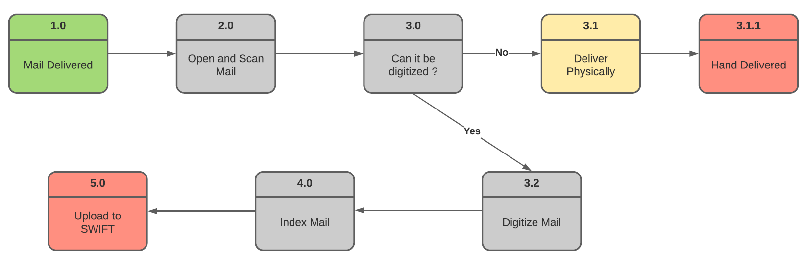
Business Process - “To-Be”
Mail that arrives at the HHS mailroom managed by PSC.
PSC would open and scan the mail in the mailroom, then transfer the digitalized mail into the SWIFT system.
SWIFT would automatically route the resulting controls to the appropriate office based on OCR keyword recognition.

Slide 5
Benefits
Benefits
Efficient processing of incoming mails
Timely delivery and redirection of mails to all program offices
Minimizing / eliminating lost or misplaced mails
Minimizing / eliminating labor intensive processes
Streamlined integration with SWIFT
Improved search capability
Timely responses by program offices to constituents

Slide 6
Costs
Cost
Automated solution to include:
Scanners
COTS
Staff
O&M
Integration with SWIFT
Training staff (PSC & ACF)

